Slide 1
Neural Ordinary Differential Equations
https://arxiv.org/abs/1806.07366
Journal Club – 11/05/22
Bhumika & Adam
Notes:
https://jontysinai.github.io/jekyll/update/2019/01/18/understanding-neural-odes.html
Other videos:
Retrospective -- https://www.youtube.com/watch?v=YZ-_E7A3V2w
https://youtu.be/-HZ3yb3qLmo?t=813

Slide 2
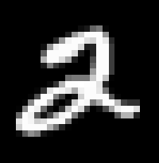
At the (very) high level
New family of continuous-depth architectures
Neural ODE: let’s use Euler’s method (or something like it) to solve (something like) a residual network but using one continuous unit instead of many discrete units
... and let it be differentiable
Stack of residual blocks → A single NODE
Downsampling layers
ODESolver
w/ODENet
FC layers
[0.1, 0.2, 1.8, 1.1, 0.2,… ,0.1]
[0, 0, 1, 0, 0, 0, 0, 0, 0, 0]
2
Authors: Ricky T. Q. Chen, Yulia Rubanova, Jesse Bettencourt, David Duvenaud
2052 citations (10/05/22)
Notes:
MNIST
ODENET = couple conv blocks of dim 64
Wraps ODENet wit h ODEBlock which has ode solver
Additional downsampling layers to get mnist inp img to feature dim and FC layers to get to dim 10 for clf
CE loss

Slide 3
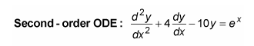
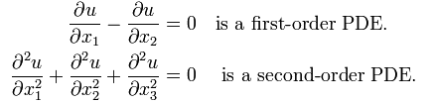
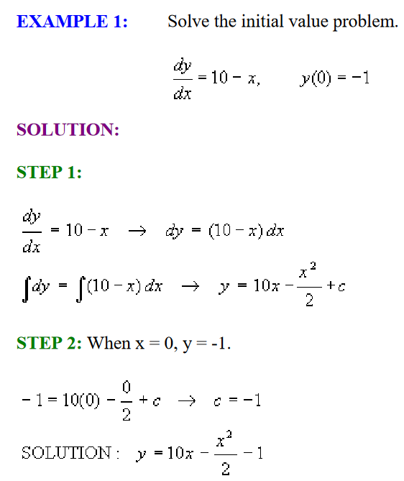
Some definitions
Differential equations: equation containing derivatives of a function.
Function derivative: Evaluated at a point, the derivative of a function gives the slope of the function.
Derivative: an operator, whose input is a function and output is also a function
2 types
Oridinary DE: Have differential equation with 1 independent variable’s derivatives
Partial DE: Have partial derivatives of multiple independent variables inside the equation
Initial value problem (IVP)
Is an ODE with some initial value (e.g., known point in the domain)
Initial value = where you start
ODE = where you go
Solving the IVP results in a function which solves the ODE and satisfies the initial value
Solving an ODE:
Finds the original function of a differential equation
“The goal of an ODE solver is to find a continuous trajectory satisfying the ODE that passes through the initial condition.” -- https://github.com/rtqichen/torchdiffeq
Notes:
https://medium.com/red-buffer/neural-odes-an-intuitive-understanding-of-the-basics-63d47464e009
NN will parameterise the vector field for the differential equation
IVP problem example from https://resources.saylor.org/wwwresources/archived/site/wp-content/uploads/2012/09/MA102-5.5.4-Equations-and-Initial-Value-Problems.pdf

Slide 4
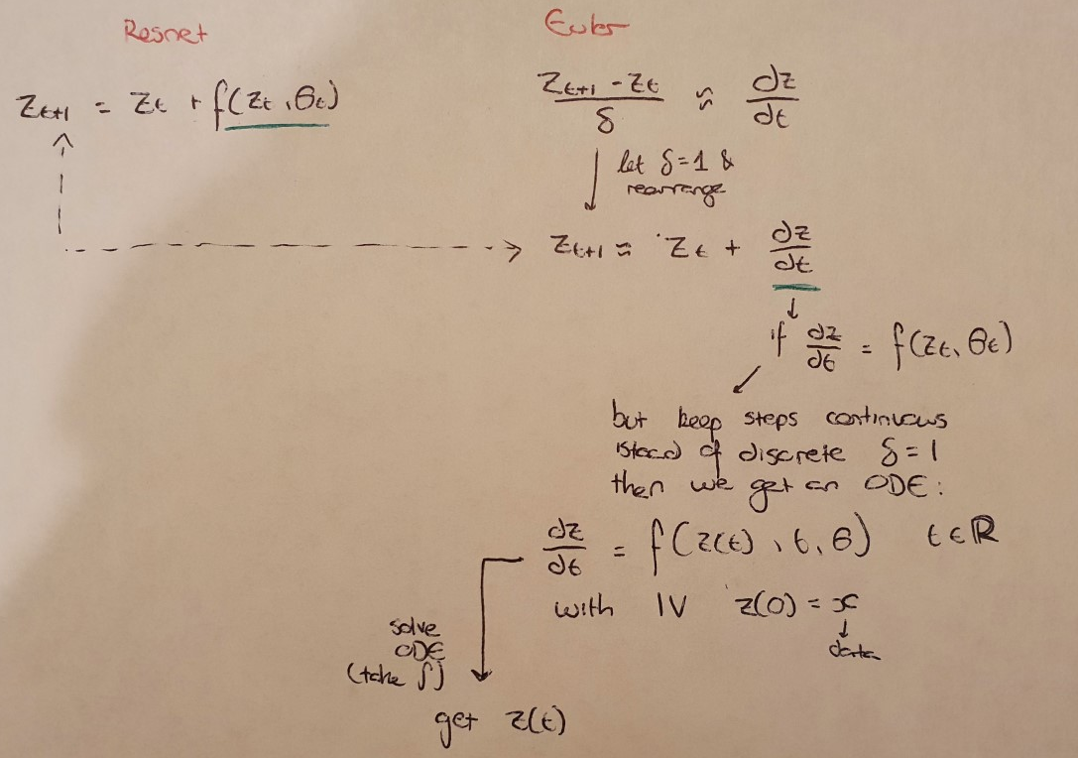
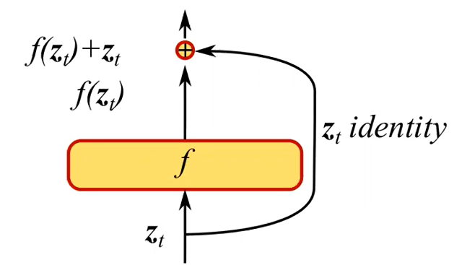
Residual form → ODE form via Eulers method
Euler: Method for solving ODEs given an IV
ResNet block:
Notes:
View iterative updates == Euler discretization
Image from: https://youtu.be/jmuKHothMR8?t=252

Slide 5
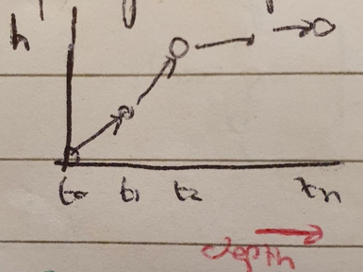
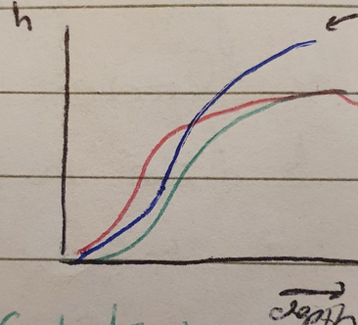
ResNet →Neural ODE; (Discrete vs Continuous)
What if:
keep adding layers and
take smaller steps
In the limit
Discrete → Continuous
Hidden unit dynamics = continuous
Paramaterised by NN via (neural) ODE
Will be an approximation
Notes:
local discretization error in the Euler method is the error made in approximating the derivative by the difference quotient.

Slide 6
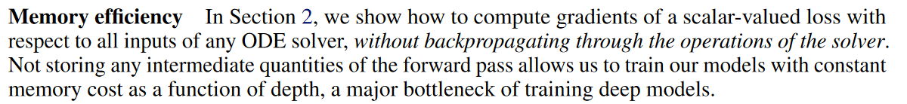
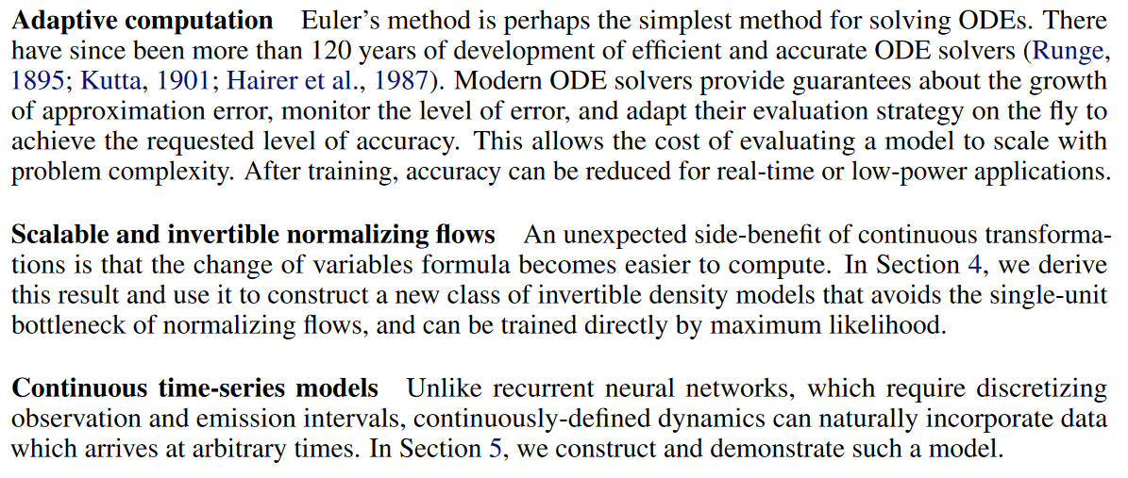
Benefits
Section 2 &
Table 1
Figure 3
Section 4
Section 5
Notes:
Mem efficiency thanks to using adjoint method for BP.
Do full procedure in constant mem O(1)
don’t store activations because can reconstruct them by running dynamics backwards in time
Adap comp = up to ODE on number of evals to do when training. During eval we can trade-off acc for time savings
Can’t control time cost of model during training, but can during test time → tradeoff speed of eval and precisions
Last 2 points = applicational

Slide 7
Be aware…
Yes, f acts on vectors not scalars
E.g., eq 1
Yes, they use z and h interchangeably
Yes, the appendix is in the wrong order
Yes, they keep using the wrong notation for vectors
Maybe eq 34 should be a gradient vector representing a partial (not full) derivative

Slide 8
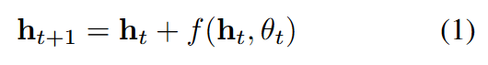
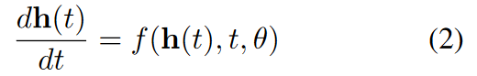
ResNet vs ODENet
ResNet parameterise the function mapping between consecutive layers
Learn weights to represent the function between hidden layers
NODEs parameterise the derivative of the hidden state over time
Learn weights to represent the derivative of the intermediary states over time

Slide 9
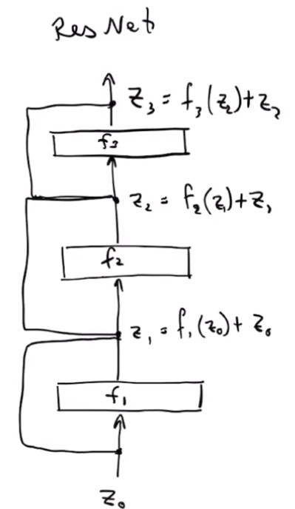
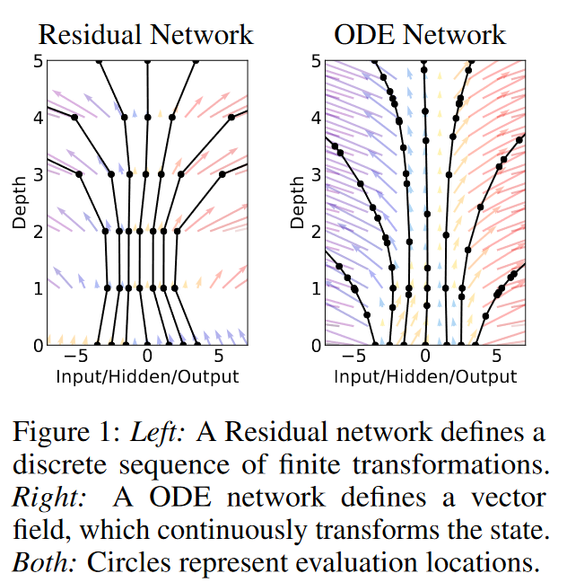
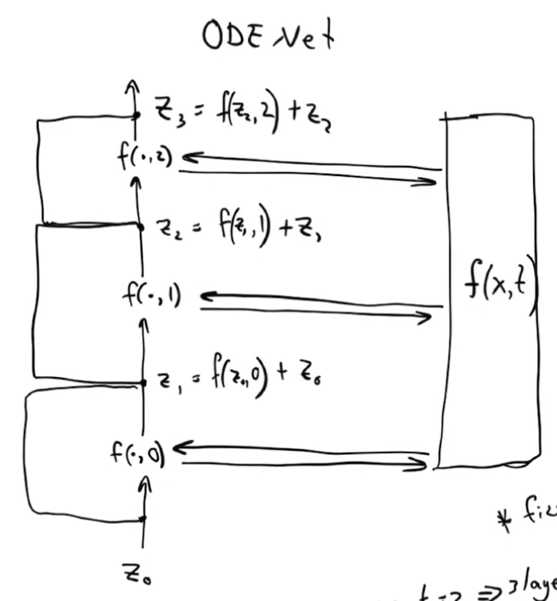
Notes:
Images from: https://youtu.be/uPd0B0WhH5w?t=138
f = NN
H_t/ h(t) = feature vector (hidden state) at layer/time t
Theta = params to learn.
- Notice how Resnet uses different params f.e. layer (‘depth’) but NODE uses shared params for all depths
Dots in Figure 1: Resnet depth is discrete (delta=1); NODE depth is continuous (unconstrained) so can get hidden state at any depth
Dots = evaluations done by the network.
Can rearrange eq 1 to start h_t = … so same form as eq 2

Slide 10
What do we have so far?
Forward pass = yep
Pass input through NN which represents an ODE of the hs dynamics dh(t)/dt
Learn a function to approximate the continuous hs dyn
Solving ODE will give us the hs at any depth t
Assume IV h(t_0) = input state vector
Assume h(t_n) = output state vector
Backwards (i.e., gradient calcs) = …

Slide 11
Reverse-mode automatic differentiation of ODE solutions
Section 2

Slide 12
Adjoint Sensitivity Method
Problem:
Backprop calculations for a continuous depth network
High memory cost from storing intermediate operations of the solver
Additional numerical error from the gradients
“Approximate the derivative, don’t differentiate the approximation!” https://youtu.be/V6nGT0Gakyg?t=230
In other words, let’s use ANOTHER ODE…
Solution:
ODE solver = Black box
Compute gradients via adjoint sensitivity method
How? Use another ODE solver (which is solved in the reverse direction)
+ve: Linear scaling to problem size, low mem £, control over numerical error
Notes:
Useful videos explaining adjoint (in order for watching):
https://www.youtube.com/watch?v=EybH_Q-QTZ8
https://www.youtube.com/watch?v=Y2Qyu1siSyo
https://www.youtube.com/watch?v=s4OBbXQxgYo
https://www.youtube.com/watch?v=wcxYbs9DV1I
https://www.youtube.com/watch?v=7CZP6dHIkNE
https://www.youtube.com/watch?v=2y0Oo9cz2HQ
Remember earlier, I mentioned that the derivative rep the ODE is an approximation.

Slide 13
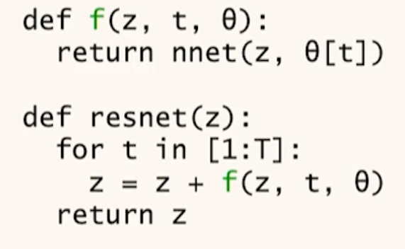
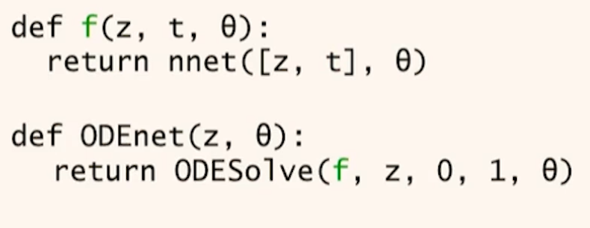
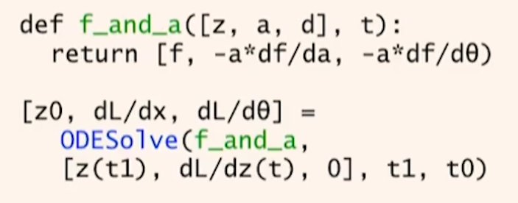
Resnet
Forward ODE#1 → f will be dz(t)/dt, so solving the ODE will give you z(t)
Backwards ODE#2 → g will be d(a(t)/d(t), so solving the ODE will give you a(t) (adjoint)= dL/dz(t).
Use AD to define adjoint dynamics
- Integrate back in time using another call to ODESolver to calculate the gradients
Notes:
Notes from https://www.youtube.com/watch?v=V6nGT0Gakyg
How to take exact derivative through ODE solution?
Taking the continuous time limit of backprop equations you get the adjoint sensitivity equations.
Use auto diff to define adjoint dynamics
Integrate back in time using another call to an ODESolver
ODE depth ~ no. eval on dyn network the ODESolver makes
Backwards ODE#2 → g will be dL/dz(t), so solving the ODE will give you a(t) (adjoint). Notice start is t1 and end is t0

Slide 14
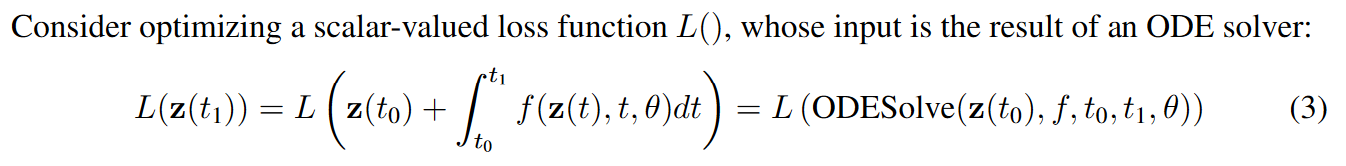
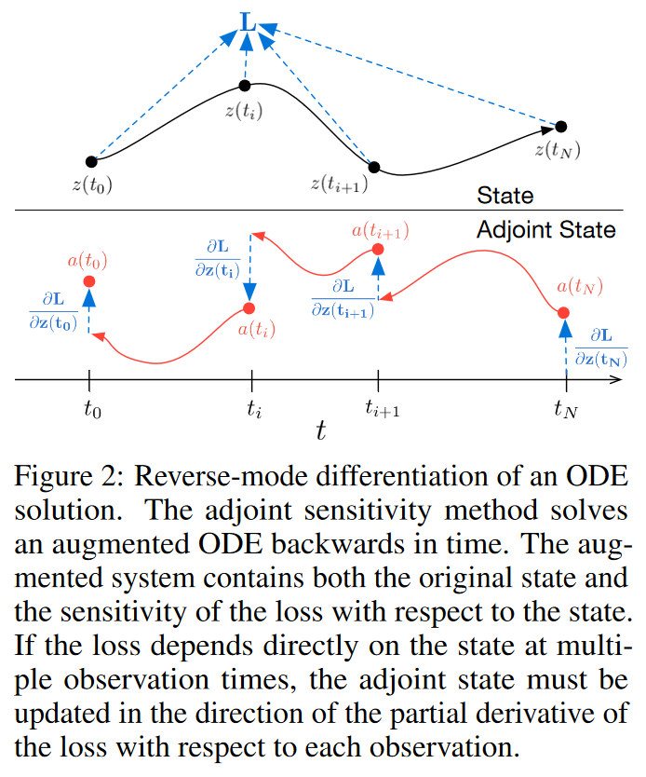
dz(t)/dt
z(t)
Side note: Optimal control form:
(see https://en.wikipedia.org/wiki/Optimal_control) General Method section
Min. continuous-time cost functional
1st term = endpoint cost
2nd term = running cost (/Lagrangian)
z = (‘hidden’) state of the dyn sys
t = ‘depth’
Theta = NN params to train
f = NN function
Notes:
Get eq 3 from rearranging euler

Slide 15
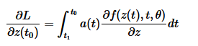
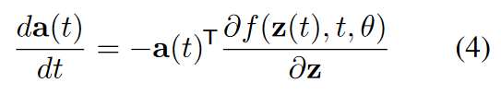
How to optimize the loss function?
To get the grad at t_0 we need to run the ODESolve backwards in time, starting from the value at t_1 as the initial point
Need grads of L wrt 4 params
a(t_0) =
Focusing on how loss depends on hs at every t (z(t)):
Define the adjoint a(t)
Learn this via solving another ODE whose dynamics represent the change in the hidden state over time
Derived in App B.1!
Notes:
https://nbviewer.org/github/msurtsukov/neural-ode/blob/master/Neural%20ODEs.ipynb
FIGURE:
Black trajectory represents solving the ODE during forward propagation.
Red arrows represent solving the adjoint ODE during backpropagation.
Black line = black box method
Blue derivatives = adjoint and we treat it as a function (red variables)
A(t_N) = initial condition (for ODE#2)
dz(t)/ d(z(t+1) = dL/dz(t+1) df/dz(t)
1st term = a(t+1); 2nd term top = ODE #2
https://medium.com/red-buffer/neural-odes-an-intuitive-understanding-of-the-basics-63d47464e009
So in Neural ODE, we are using Euler’s method to solve something that looks like a residual network but has just one continuous unit instead of many discrete units. And the way to optimize is that we use the 1. Change in Loss wrt parameter (one): dL/dtheta 2. Change in Loss wrt hidden state (time t): dL/dh(t) 3. Changes in hidden states themselves: dh/dt

Slide 16
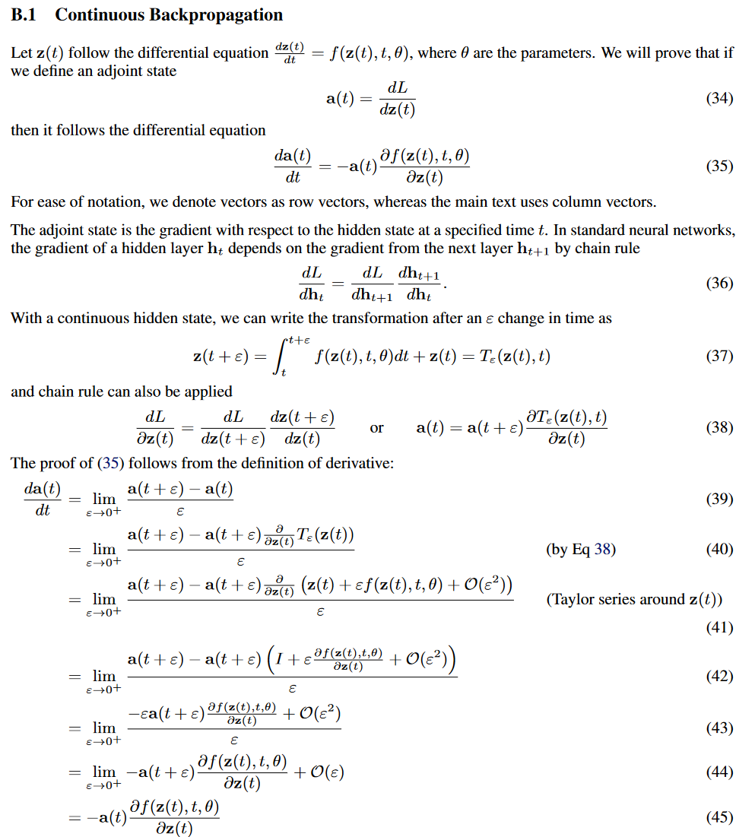
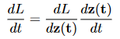
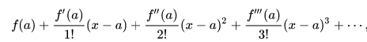
Adjoint state – change of loss wrt hs
What we want to prove:
Negation symbol due to eq.39-45
Discrete view of hidden state (e.g. resnet) with chain rule application
Same form used in eq.3
LHS: Continuous version of eq. 36
RHS: LHS using adjoint notation and def in eq 37
Typo?
Classic grad = rise/run
Expand out last term (d/dz(t))
Expand –a(t+eps) and simplify
Cancel out eps
Take eps to limit
Notes:
Derivation for eq.4 i.e. how the change of the hidden state changes with time. This is the second ODE which is solved BACKWARDS in time

Slide 17
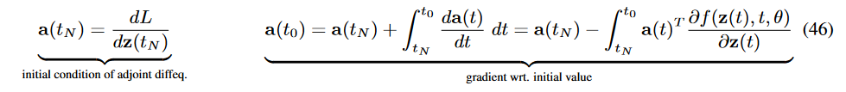
Second (backwards) ODE to solve
Notes:
Explain jumps
So solving the 2nd ODE gives us the adjoint state (loss wrt hs at time t).
And we can do something similar to get the other derivatives for theta and t’s.

Slide 18
Augmented State Dynamics (App. B.2)
Define z, theta and t wrt t
Create augmented state for z, theta and t
Differential eq d/dt
Adjoint state a(t)
Define augmented state dynamics daug/dt
Rep dyns via the adjoint ODE a_aug wrt t
The bp algo can be solved via a call to a 2nd ODE to solve the aug state dynamics (i.e., gets you the z, theta and t)
Notes:
State dyns = how state changes as time changes

Slide 19
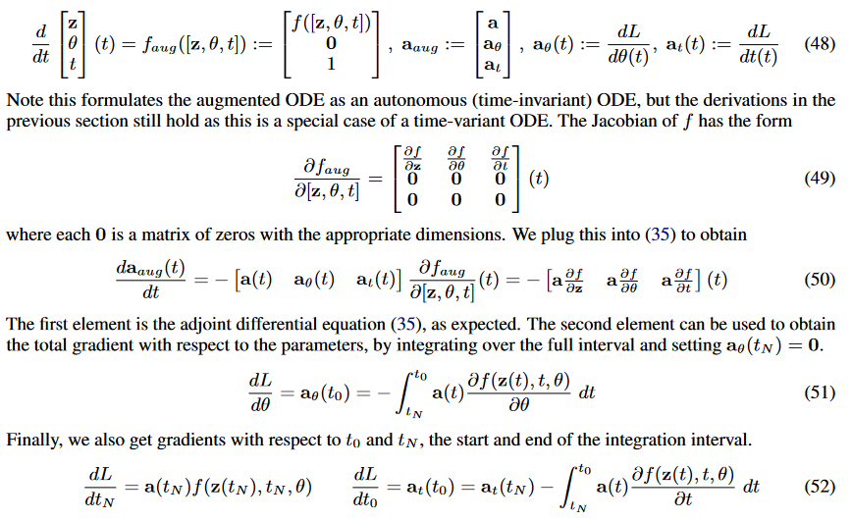
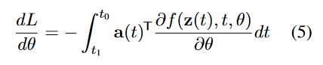
Define state dynamics wrt change in time
Augmented state dynamics:
ODE#1 to solve
Adjoint state for aug state:
Aug. state = [z, theta, t]
Grads for the augmented dynamics
Note: 0’s are matrices
Augmented adjoint state ODE
- Using proof from App. B.1
Solving the adjoint augmented ODE IVP (wrt to theta)
&
Final state (in forward)
Solving the adjoint augmented ODE IVP (wrt to t)
What does this mean?
We’ve obtained the 4 derivatives required (see few slides back) to optimize the loss!
By making 1 call to the ODE solver on the augmented state dynamics we can solve the backpropagation algorithm
Notes:
https://jontysinai.github.io/jekyll/update/2019/01/18/understanding-neural-odes.html

Slide 20
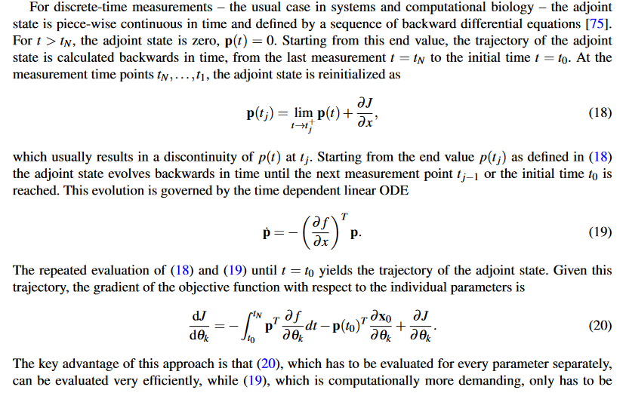
https://arxiv.org/pdf/1711.08079.pdf - sec 2.4.2
Notes:
Bit more inshight into dL/dtheta_k

Slide 21
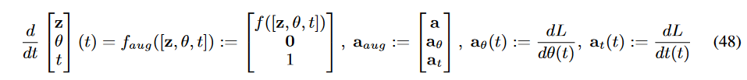
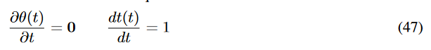
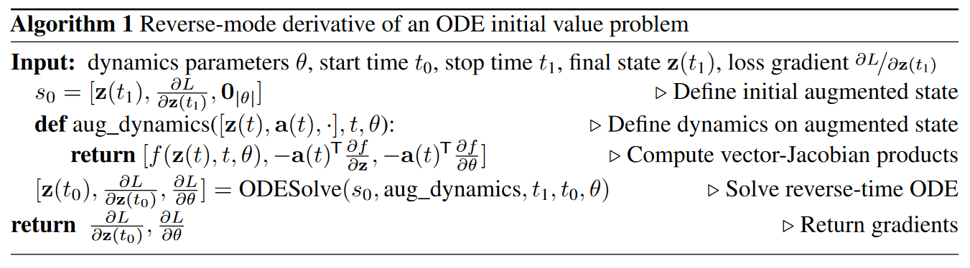
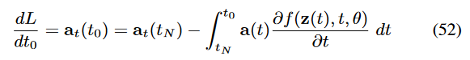
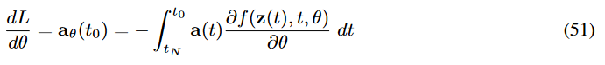
Can calc integrals for (t0, t1 and theta) via 1 call to the ODE solver (App B)
Notes:
Link algo 1 to App B.1 eq’s.
Solving ODE#2 → adjoint wrt t to get the adjoint = loss wrt hs/theta/t

Slide 22
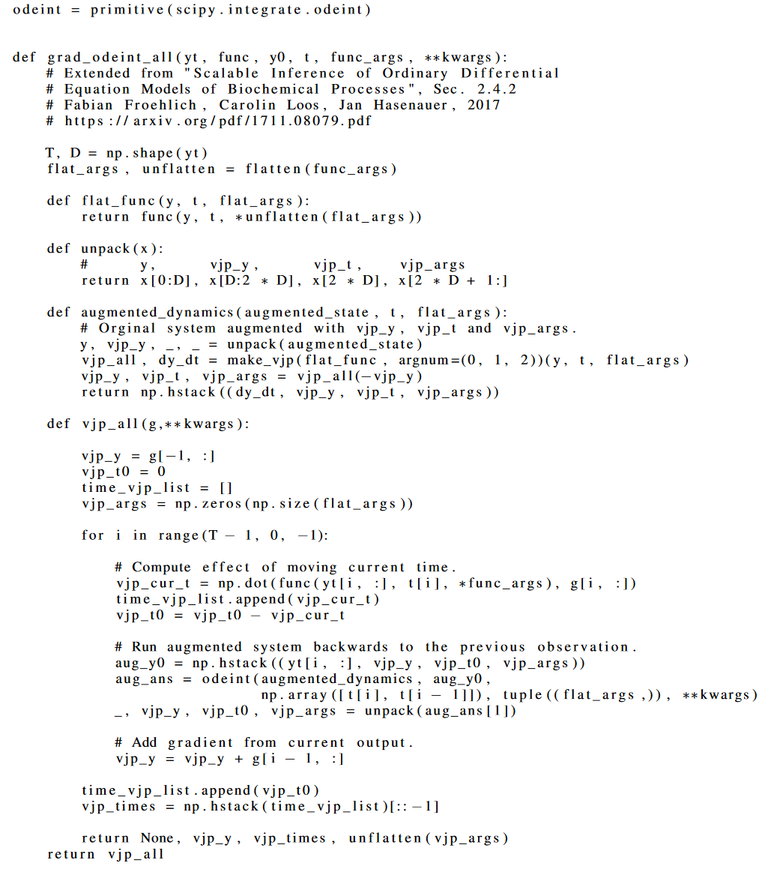
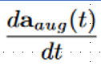
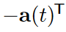
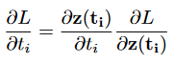
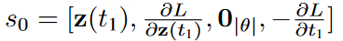
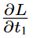
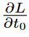
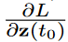
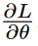
Algo to solve IVP via ODE solver
z(t_N)
z(t_0)
NN=dz(t)/dt=f
…
y = z(t)
vjp_y = a(t)
Calc aug adj state
Last ts adjoint state: a(t_N)
Going backwards t_N → t_0
Current adjoint state: a(t_i)
Move in direction of new update?
Initial aug state
???
Notes:
Deeper look into how the second ODE works
Explain app D (using personal notes)

Slide 23
Experiments

Slide 24
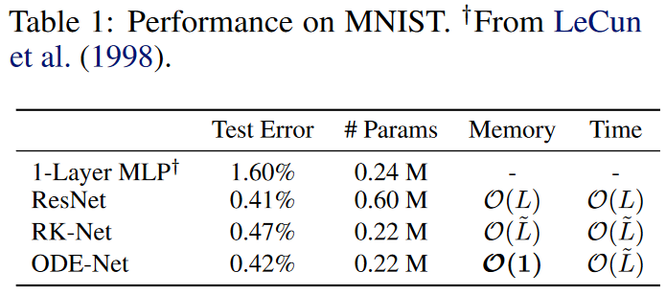
O(1) Memory Cost
ODEs have similar performance to ResNet but with less params
Adjoint sensitivity method allows ODE-Net to have constant memory costs
Notes:
L = #layers in ResNEt
L^~ = #func evals of ODE solver in forward pass (= implicit number of layers)
Less params because params are shared over the depth

Slide 25
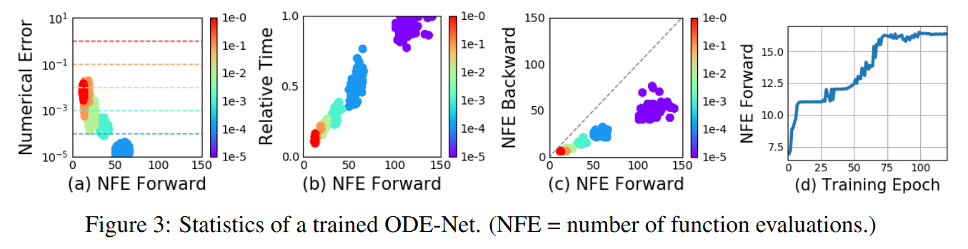
Error Control in ODE-Nets
Error control = make sure output is within given tolerance of the true solution
Trade-off: Accuracy vs computational cost
‘Depth’ is up to the ODE solver
Time in forward is proportional to num func evals (NFE)
more epochs = more NFE
(solver needs more evals to adapt to model complexity)
Output error can be controlled (eval mode)
Num evals in bp ~ ½ evals in fp
Notes:
3a) Different evaluations on test set
3c) Suggests adj sens method is also more computationally efficient than direct bp through the integrator

Slide 26
Continuous Normalising Flows
Build complex probability distributions by transforming simple ones
Change in variables theorem calculates changes in probability
Change in density due to mapping through a function is given by the determinant of the Jacobian of the function
Known (‘simpler’) dist.
Normalizing:
Ensure valid PDF so integral is 1
Chain rule

Slide 27
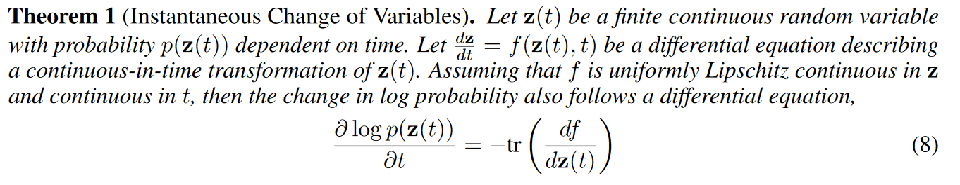
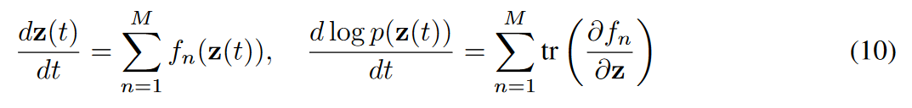
If make instantaneous (/infinitesimal) change to a variable, then how does the density change with time?
Proved that the log density wrt time is given by the trace of the Jacobian
Called this the instantaneous change of variables formula
Use theorem to build new class of generative density models (CNFs) which continuously transform a simple dist into a complex but normalised one
Notes:
Their proof is in app A is convoluted. Use Adam’s way instead.

Slide 28
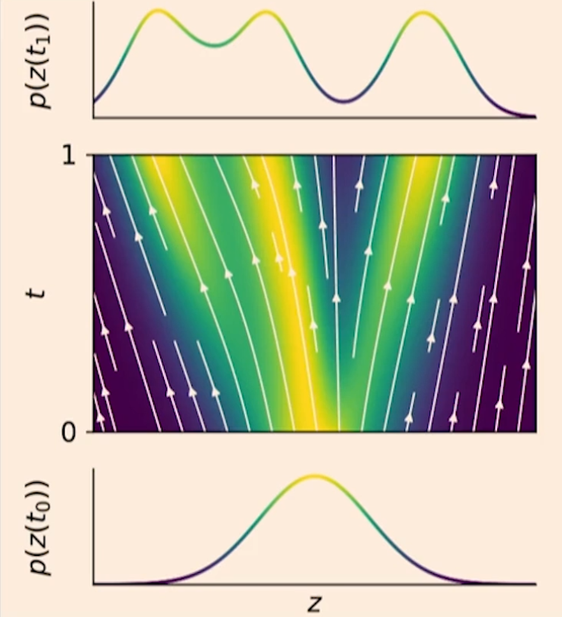
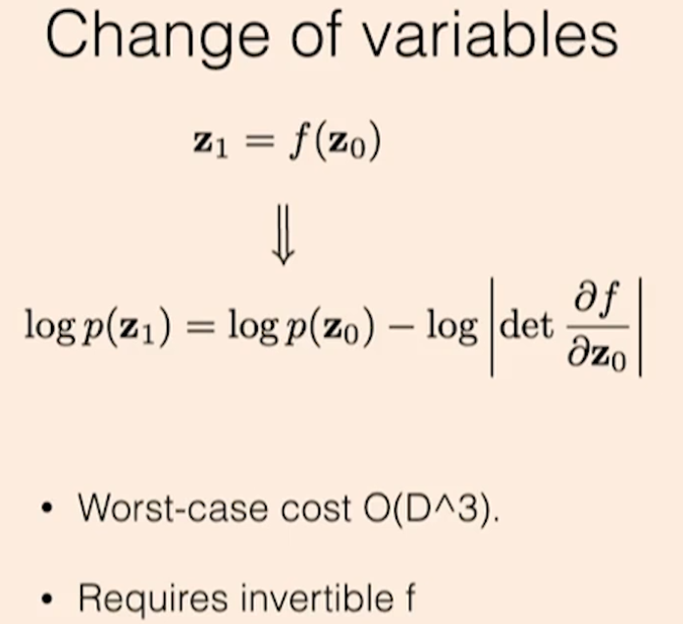
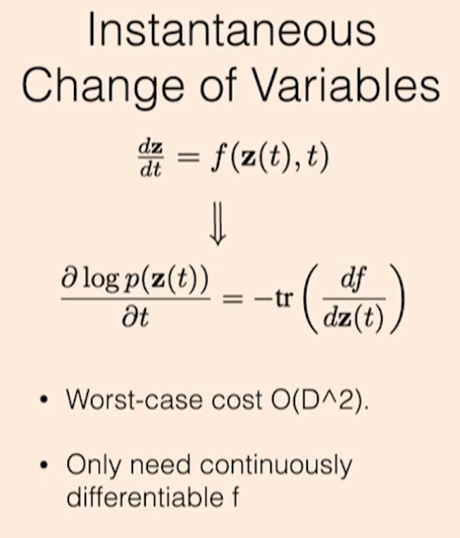
Notes:
Figure from their follow up paper (https://arxiv.org/pdf/1810.01367.pdf) which focuses on applying NODE to generative density modelling.
FROM VIDEO - https://www.youtube.com/watch?v=V6nGT0Gakyg
NF brief expl video: https://www.youtube.com/watch?v=i7LjDvsLWCg
Biggest benefit to changing to continuous time = density modelling
Change in vars formula → change in density due to mapping through a function is given by the determinant of the jacobian of the function
If make instantaneous (/infentesimal) change to a variable, then how does the density change with time
Paper proved that the log density wrt time/depth is given by the trace of the Jacobian
They call this the instantaneous change of variables formula
Trace cheaper op then determinant and doesn’t require NN to be invertible (just needs to be continuously differentiable).
Use theorem to build NEW class of generative density models (CNFs) which continuously transform a simple dist into a complex but normalised one
CNF nice properties:
Give exact normalised densities
Due to dynamics being reversible, you can train them directly from data samples unlike traditional NFs (i.e. train via ML)
Can train with SGD; don’t need discriminator
Don’t need to restrict network architecture

Slide 29

Density matching
CNF: M ‘h.units’; 10K its.
NF:K layers; 500K its.
Learn target dist.
CNF has lower loss
No y scale?
For lower depth/width, CNF is more interpretable
Visually, CNF for deeper/wider models seem worse than NF (e.g. K/M=32)?

Slide 30

ML Training
CNF: 64 h.units
NF: 64 stacked h.units
CNFs can do reverse transformation (at same costs as forward pass) so we can train via ML estimation
For NF it’s too expensive to do a reverse transformation
“CNF rotates the planar flows so that the particles can be evenly spread into circles”
% = ???
Notes:
Nosie to data
Train on density est task and sample from learned density
Density estimation = estimate prob based on data for unobvs pdf

Slide 31
Generative latent function time-series model
Looks at irregularly sampled data
E.g. medial records
Represent each time series by a latent trajectory
Local initial state z(t_0)
Shared latent dynamics (across all times series)
Input = discrete sequence
Output = decode continuous sequence

Slide 32


Continuous Time RNNs
Parameterised dist.
(decoder)
(VAE-style inference using encoder)
Can predict forwards/backwards in time (at arb. positions)
Notes:
Deal with ts which aren’t regularly sampled
+ve = not limited to RNN ts sample size
Decouples dynamics and inference
Appendix E
----------------
Irregular time observations
Separate dynamics from inference

Slide 33


Poisson Process Likelihoods
Condition latent state on arrival times
Rate function = function of latent state
Poisson likelihood = integral which can be solved with the latent state

Slide 34



Time series with irregular time points
RMSE for 100 time points past the training range (red line)
Notes:
Section 5.1 Time-series latent ODE exps
Check ability of latent ODE to model and extrapolate time series.
2D observations sampled at irregular time
Enc = RNN (25 h.units)
Latent space = 4 dim
- dynamics = f = 1 h.layer with 20h.units
Deco p(x_ti| z_ti) → NN = 1 h.layer 20 h.units
Baseline = RNN to min neg gaussian log-likelihood
Bi-dir spiral dataset
1000 2d spirals
Sampled at 100 (equally spaced) ts
2 types -> clockwise and anticlockwise
+ gaussian noise
Time series with irr time points
Sampled either 30,50 or 100 points (without replacement) from trajectory
RMSE for 100 time points past the training range (red line?).

Slide 35

Latent space interpolation
Notes:
(c) – bi-dir spiral dataset
Project latent traj onto 2 dims of latent space
Shows 2 clusters; 1 f.e. spiral direction
Fig 9 -> smooth change when change a dim in the latent space. Seems to control rotation of the spiral (in y axis)

Slide 36
Limitations (mentioned in the paper)
Minibatching
Different batch items will require different amounts of evaluation of the ODESolver
Uniqueness (and solution to IVP)
ODE solutions may not be unique if dynamics are not continuously differentiable and Lipshitz.
Requires NN to have finite weights and Lipschitz nonlinearities (e.g. tanh and relu)
Setting tolerances
User needs to set the error tolerance
Reconstructing forward trajectories
Can incur extra error if the reconstructed trajectory diverges from the original
Addressed via checkpointing to store intermediary values

Slide 37
Limitations (extra ones)
Not as expressive as Resnets
ResNets can be universal approximators
NODEs can struggle in learning diffeomorphism problems:
Require additional dimensions to learn functions that cross-over (e.g., f(x) = -x) (https://arxiv.org/abs/1904.01681)
NODE are not universal approximators but can be made into one by augmenting additional dimension (https://arxiv.org/abs/1907.12998)
Scaling up → more practical application scenarios?
FFJORD (ICLR 2019) which is their follow up work applying NODEs to density estimation
Time-series modelling assumes dynamics are deterministic
All information must be ‘crammed’ into the initial state
Stochastic changes to the state must be added separately
Solution: Stochastic differential equations

Slide 38
Summary
Neural ODE → Continuous depth neural networks by solving ODEs
O(1) memory thanks to the adjoint method
Continuous Normalising Flows
Time-series with irregular observation times
Computation time → depends on ODE solver
But can get error control via setting the tolerance parameters
Trade-off run-time vs accuracy

